Slide 1


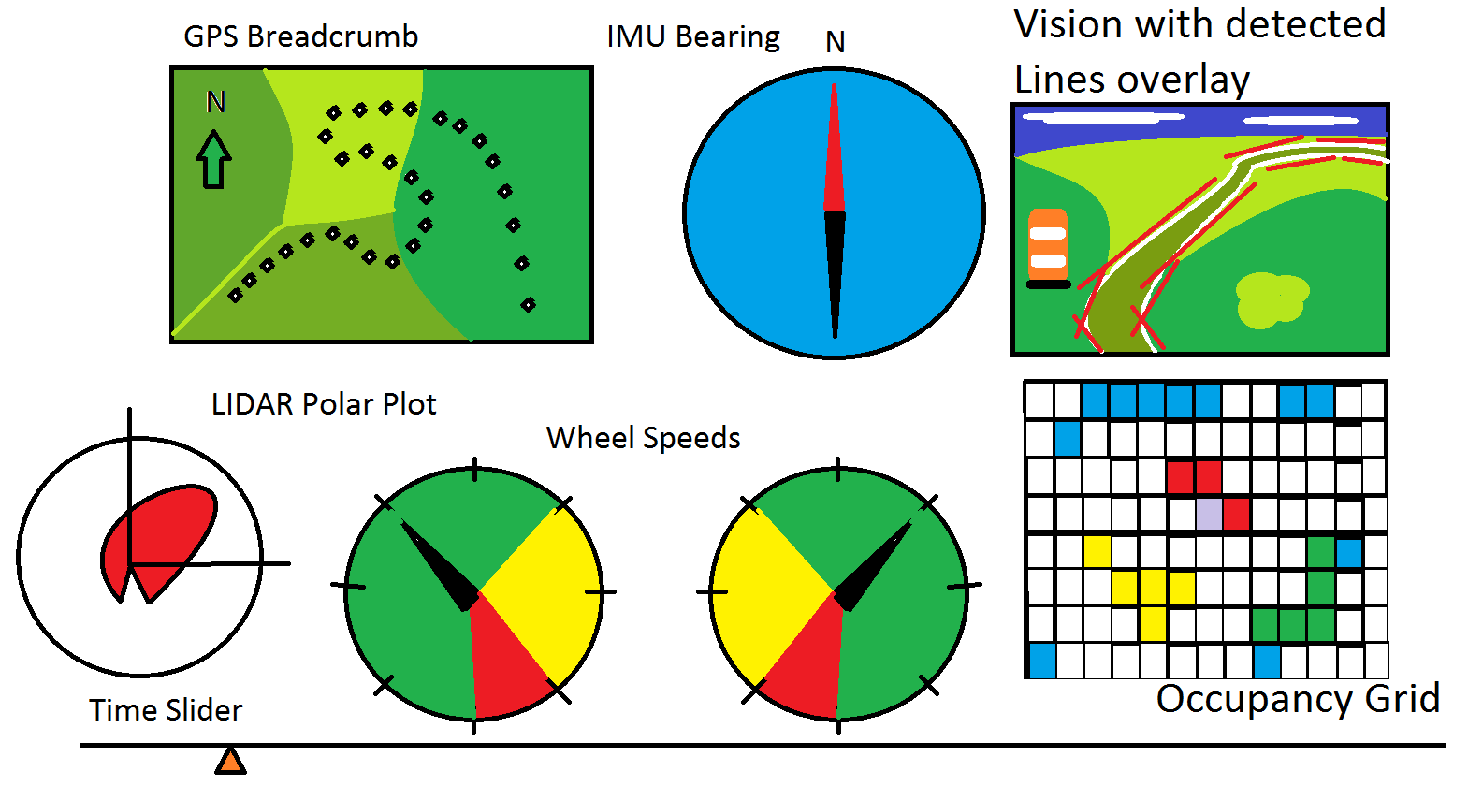
IGVC Vision
CSSE463 – Image Recognition
Team Members:
Donnie Quamme, Ander Solorzano, Ruffin White, Kurtis Zimmerman

Slide 2
PURPOSE
To aid the Robotics Team develop image recognition features for IGVC
Avoid obstacle collision
Avoid crossing lines
Maneuver around colored gates
Adapt to various lighting conditions
Fully autonomous
Efficient path planning
GPS Navigation
Time limit

Slide 3
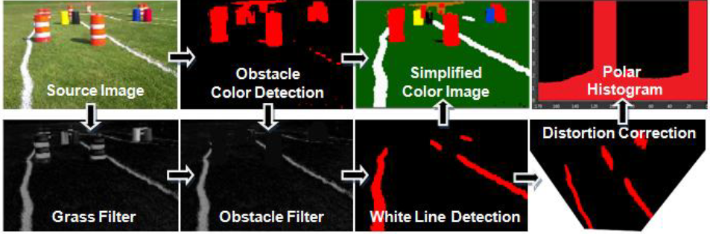
DESCRIPTION
Our selected procedure
IMAGE ACQUISITION
PERSPECTIVE CORRECTION
GRASS AND NOISE FILTERING
OBSTACLE DETECTION
BUILD MAP
LINE DETECTION
Basic idea for efficient image recognition
Attributed to California State University

Slide 4
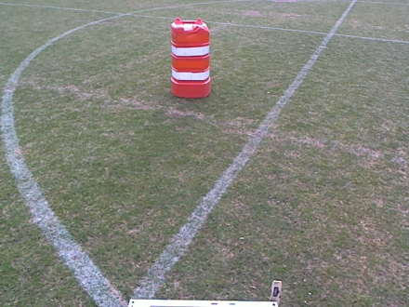
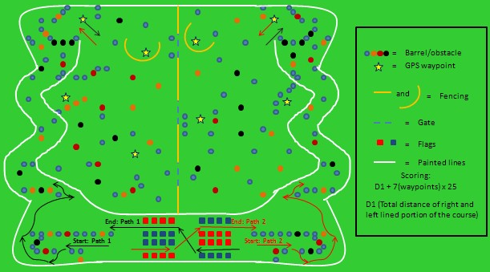
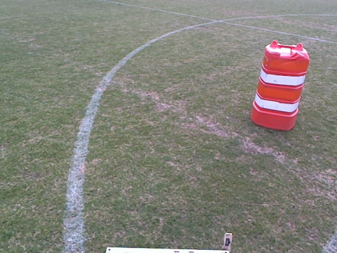
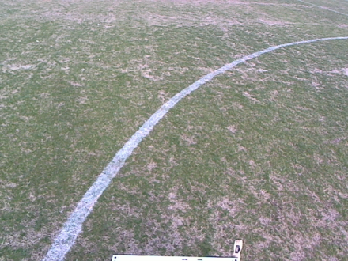
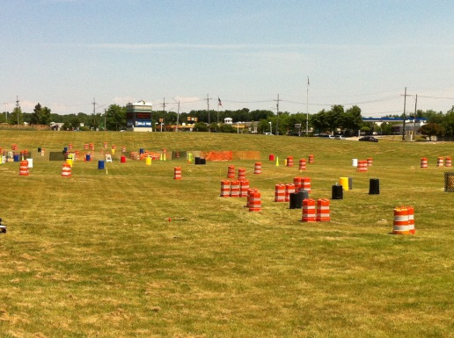
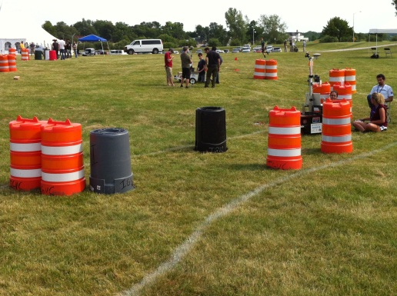
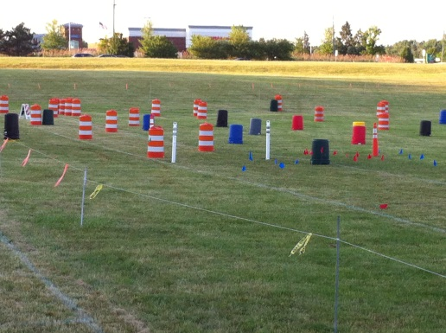
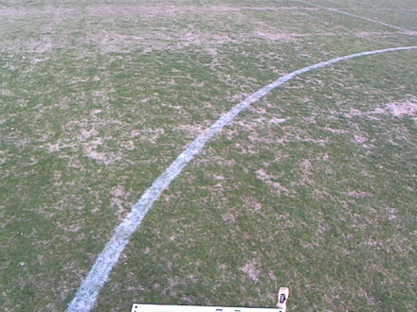
IGVC FIELD IMAGES

Slide 5
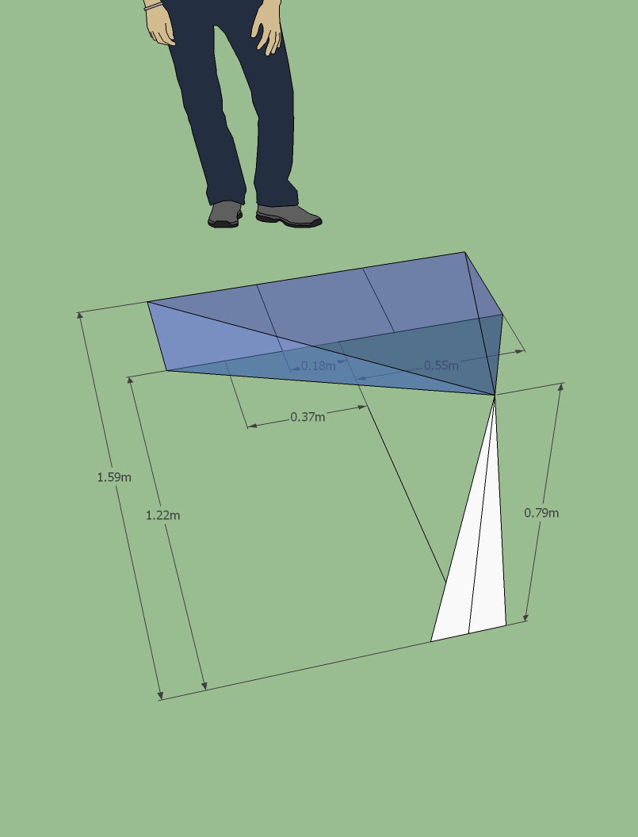
Perspective correction
Setup calibration environment
Measure and calculate positions

Slide 6
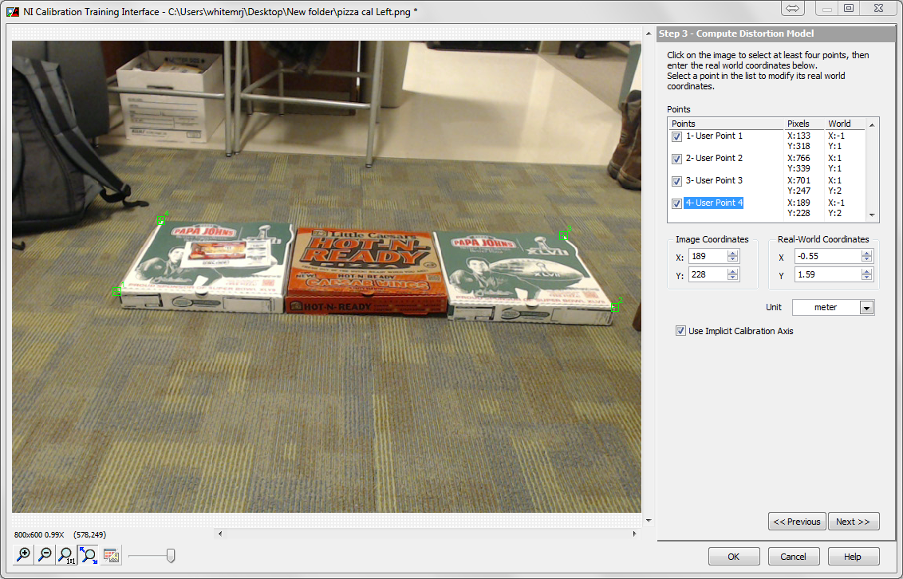
Capture the calibration image
Initializes ROI and coordinates

Slide 7
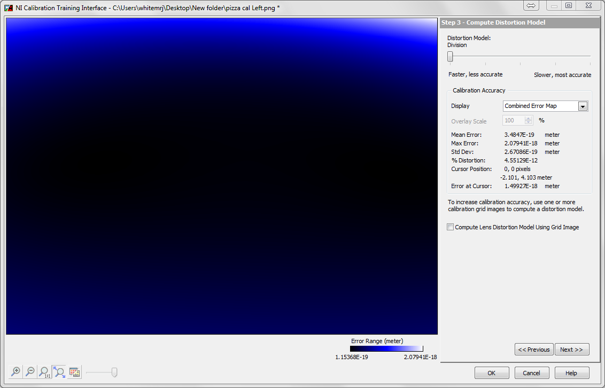
Construct calibration file
Verify calibration errors

Slide 8
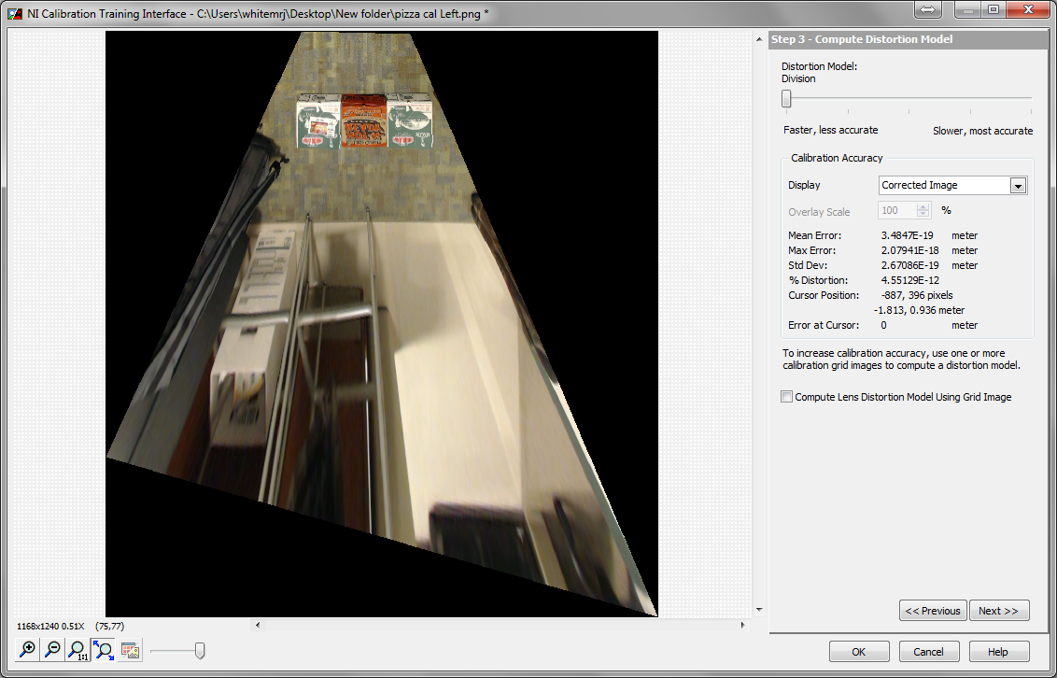
Apply calibration file to sample image
The ROI is now distorted for perspective

Slide 9
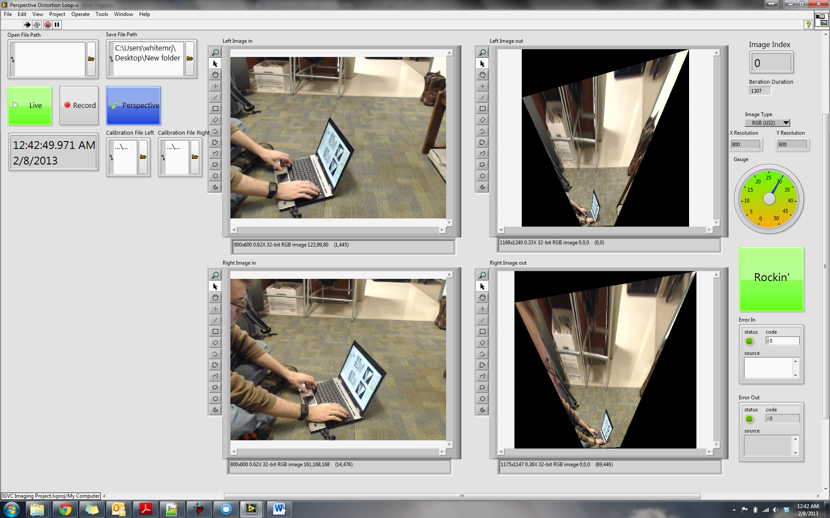
Repeat calibration for each camera
Apply distortion to live video

Slide 10
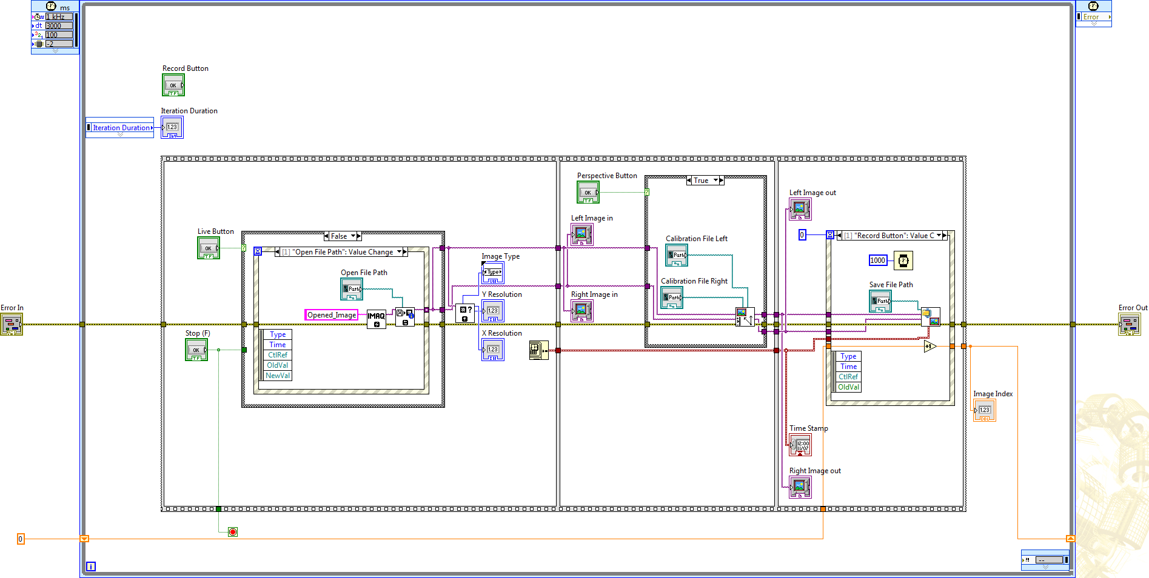
Three step sequence
Acquire image file or live video
Processes frame for perspective
Save results to file
1
2
3

Slide 11
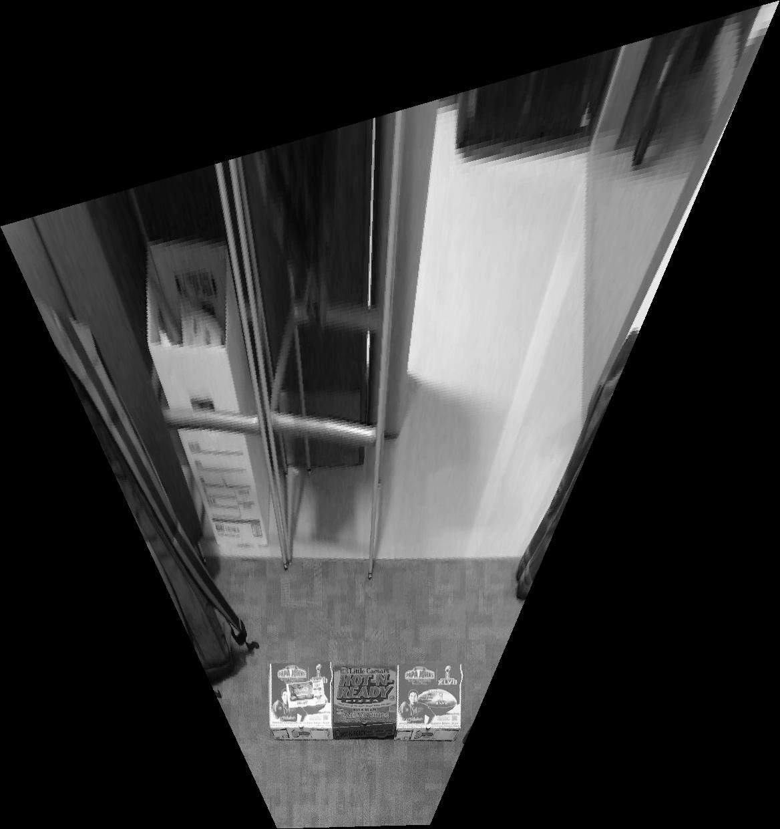
Orientation and perspective corrected

Slide 12
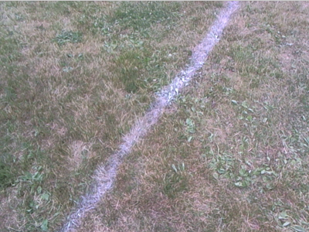
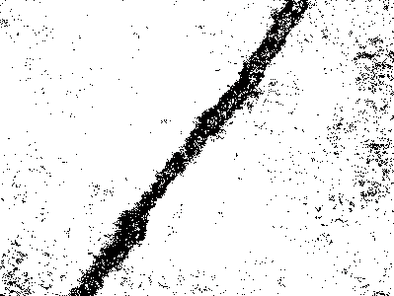
Grass and noise filtering
Images with distinct grass and painted grass regions were identified as such

Slide 13
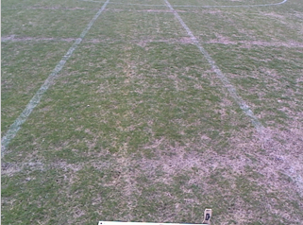
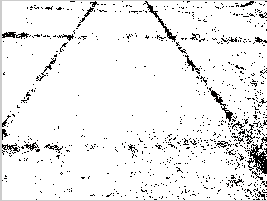
Faded lines were frequently identified as unpainted grass while dying grass identified as painted line

Slide 14
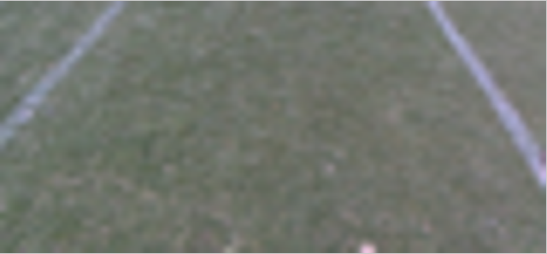

Performed very well on a majority of images. When it worked it worked well.

Slide 15
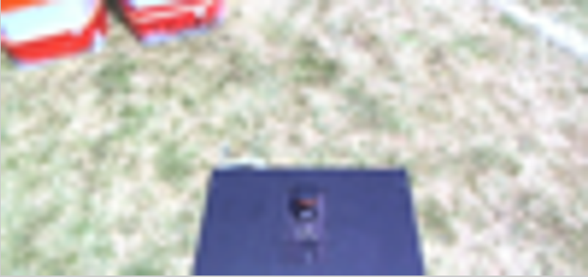
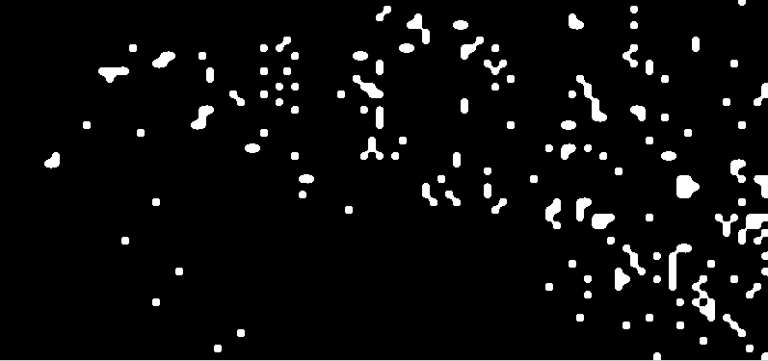
In the following image, what is grass vs. noise?
When it fails…
…it does spectacularly!

Slide 16
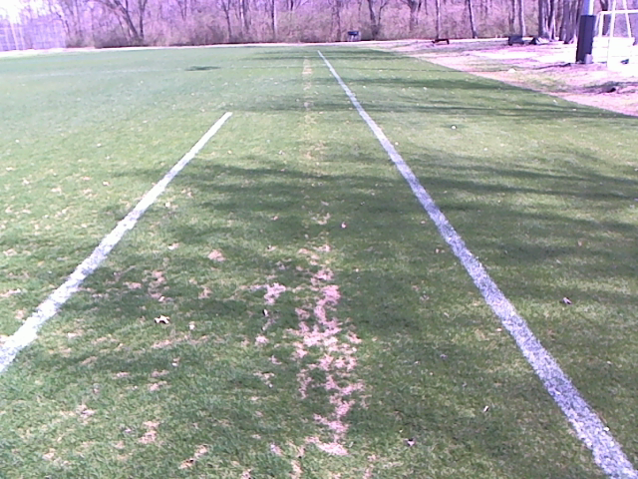
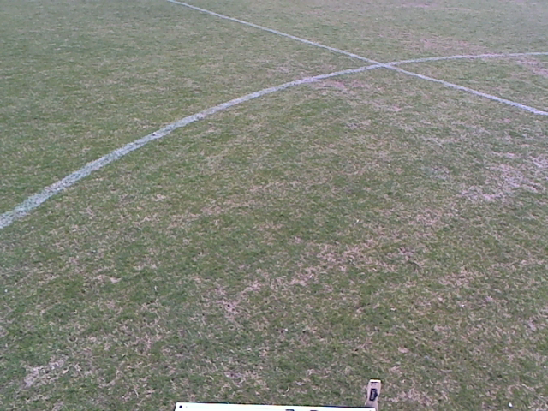
Line detection
Various types of white lines
Different orientations
Lighting and shading
Natural grass patterns
Patches of dirt

Slide 17
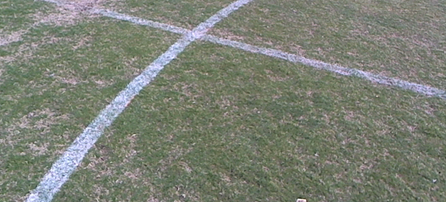
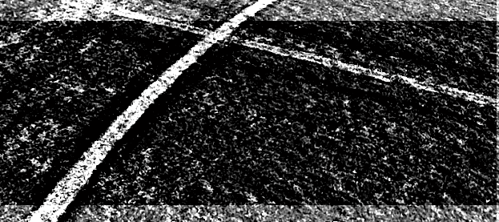


Used relative brightness algorithm from GOLD Report
Value band from HSV used as brightness indicator

Slide 18

Implemented relative brightness detection as a filter to speed up computation

Slide 19
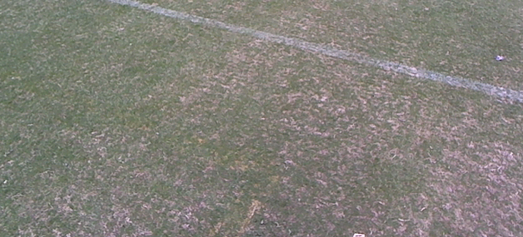
Faded or distant lines not consistently detected
Bright barrels can interfere with line detection
Perspective affects uniformity of line widths

Slide 20
Obstacle detection
Construction barrels
Colored barrels
Red and blue flags
Construction fences (LIDAR)
Unknown objects (LIDAR)

Slide 21
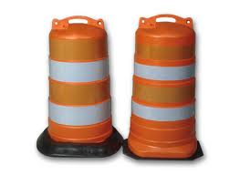
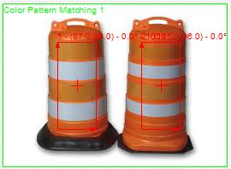
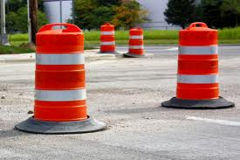
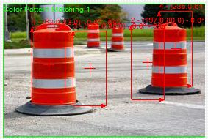
Barrel detection via color classification
Advantage
Works well on ideal samples (noise filtered out)
Done in color space
Disadvantage
Tends to fail without filtering out noise
Fails if the dimensions of the barrel varies too much

Slide 22
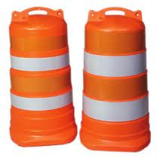
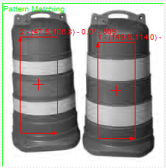
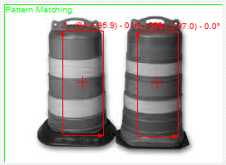
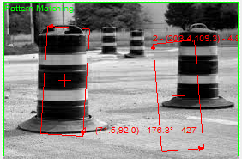
Barrel detection via template matching
Advantage
Performed better even with noise
Able to detect a wider range of matches
Disadvantage
More efficient if priori of world is known
Fails if match has too much shadow or too much light
Done in grey space

Slide 23



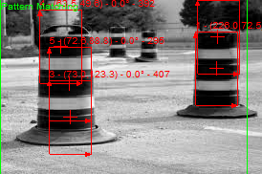
Improving the barrel detection
Use monochromatic bands in template

Slide 24
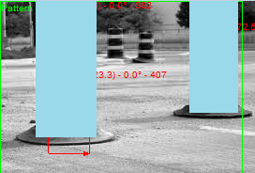
Create a “skyscraper barrel” mask
Needs implementation with other techniques
Reasoning
Robot cannot fly or jump over obstacles
Advantage
Less computation time
Robot should only care about immediate obstacles
Don’t care about smaller templates (too far)

Slide 25
THE NEXT STEP
Perspective Correction
Obstacle Detection
Line Detection
Grass Filter
Build map and plan path to Victory

Slide 26
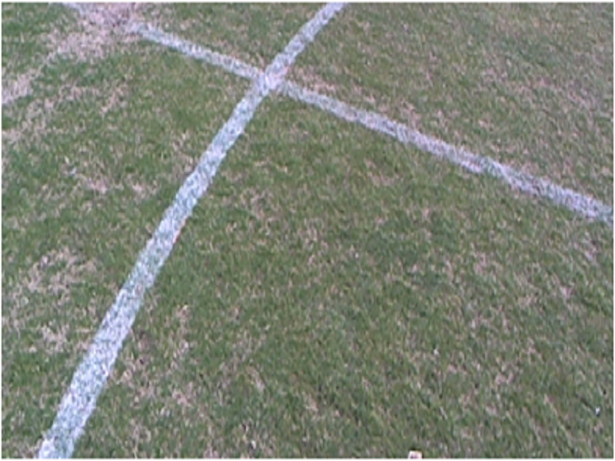
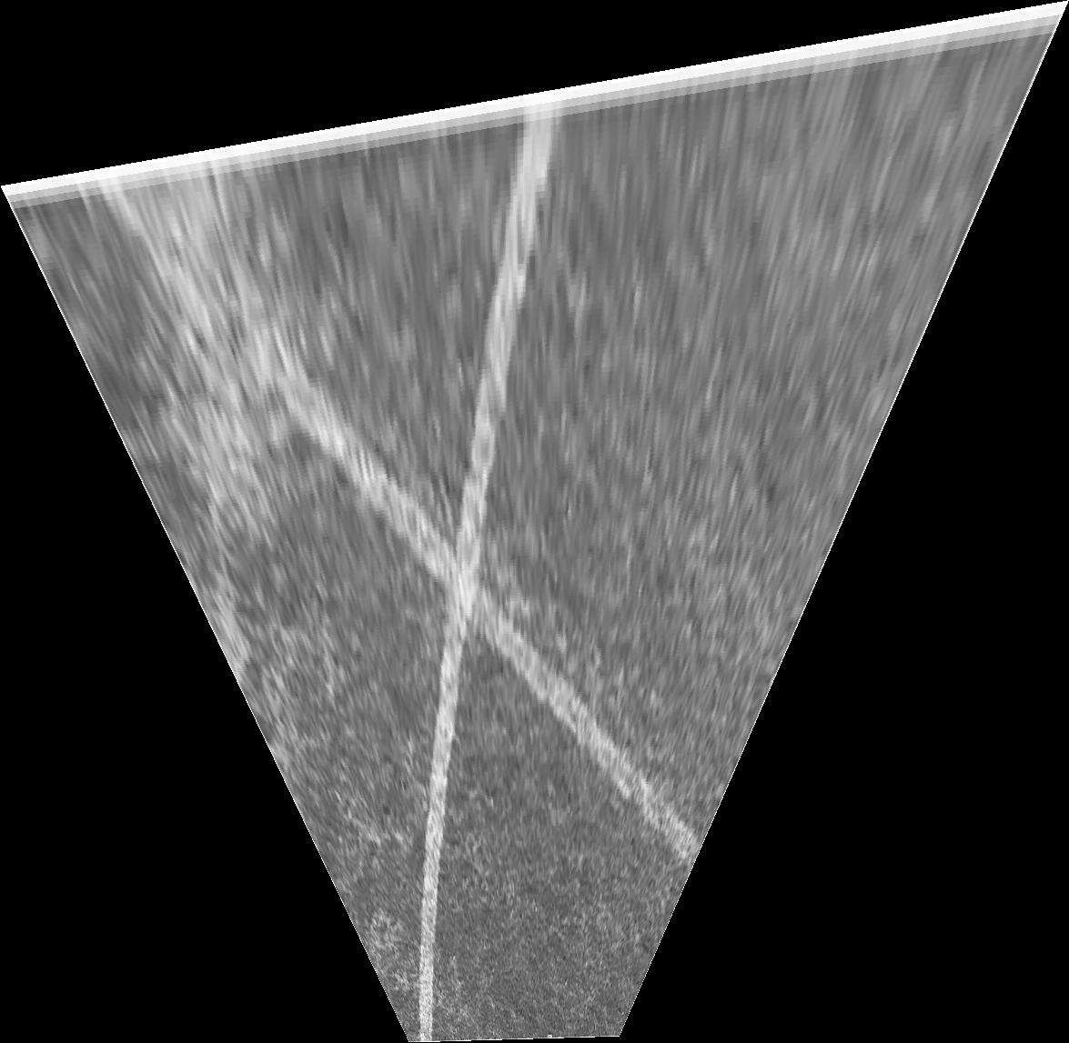



Slide 27
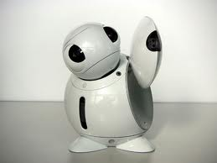
QUESTIONS
>Live DEMO

